Slide 1


Ganesh Gangaram Shelar
10-08-2023

Slide 2

Outline
Executive Summary
Introduction
Methodology
Results
Conclusion
Appendix

Slide 3
Executive Summary
The project aimed to predict the success of SpaceX rocket landings. Data was collected from the public SpaceX API and SpaceX Wikipedia page. A 'class' column was created to classify successful landings.
Data exploration was conducted using SQL, visualization, Folium maps, and dashboards. Relevant columns were selected as features. Categorical variables were converted to binary using one-hot encoding. Data was standardized for consistency.
Four machine learning models were implemented:
1. Logistic Regression
2.Support Vector Machine
3.Decision Tree Classifier
4.K Nearest Neighbors
All models achieved an accuracy rate of approximately 83.33%.
The project faced limitations due to data availability.Challenges included addressing data quality issues and achieving a balanced dataset.

Slide 4
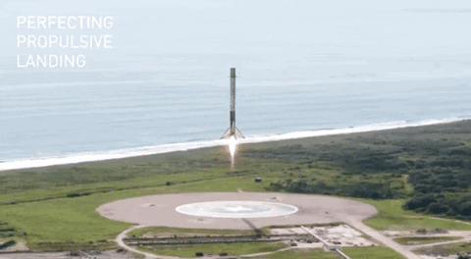

Introduction
Welcome to the culmination of our IBM Data Science Capstone project—predicting the outcome of SpaceX rocket landings. In a world where space exploration pushes boundaries, our project leverages data science to forecast the success of these missions.
SpaceX's pursuit of innovation is inspiring, yet every launch carries inherent risks. Through meticulous data collection, feature engineering, and machine learning, we've developed models with an impressive accuracy rate of approximately 83.33%. However, as we'll discuss, our models have a tendency to over-predict successful landings, indicating a need for more data and refinement.
Join me as we explore the intersection of data science and space exploration.

Slide 5

Section 1

Slide 6
Methodology
Executive Summary
Data collection methodology:
Combined data from SpaceX public API and SpaceX Wikipedia page
Perform data wrangling
This data wrangling methodology ensured that the dataset was prepared systematically and efficiently for the predictive modeling phase of the project.
Perform exploratory data analysis (EDA) using visualization and SQL
Perform interactive visual analytics using Folium and Plotly Dash
Perform predictive analysis using classification models
Build, tune, evaluate classification models

Slide 7
Data Collection
In our project, we meticulously gathered data from two primary sources: the SpaceX API and the SpaceX Wikipedia page. This dual-source approach allowed us to access a comprehensive dataset for analysis.
SpaceX API: We leveraged the SpaceX API to access up-to-date and structured information on rocket launches and landings. By making API requests, we retrieved data on launch outcomes, mission details, and other pertinent information. This real-time data stream provided us with the latest insights into SpaceX's missions.
SpaceX Wikipedia Page: In parallel, we consulted the SpaceX Wikipedia page, a valuable source for historical records and contextual data. This page offered a wealth of information, including mission descriptions, historical context, and specific details about rocket landings.

Slide 8
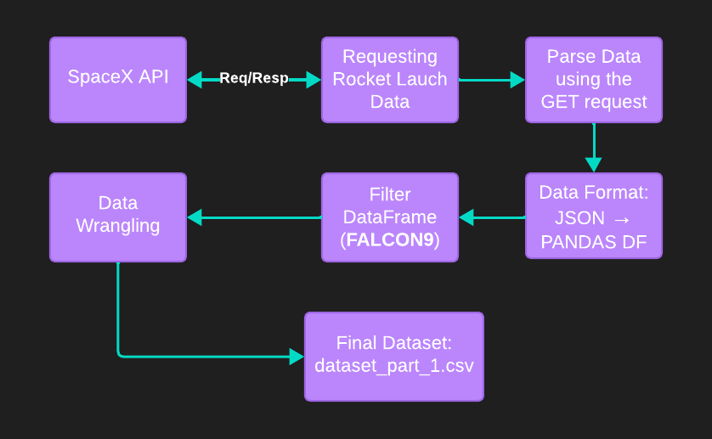
Data Collection – SpaceX API
To access data from the SpaceX API, you would typically need to make HTTP requests to the API endpoints, parse the JSON responses, and then use the data for your analysis or applications.
Data Columns: FlightNumber, Date, BoosterVersion, PayloadMass, Orbit, LaunchSite, Outcome, Flights, GridFins, Reused, Legs, LandingPad, Block, ReusedCount, Serial, Longitude, Latitude, Class.
GitHub Link

Slide 9
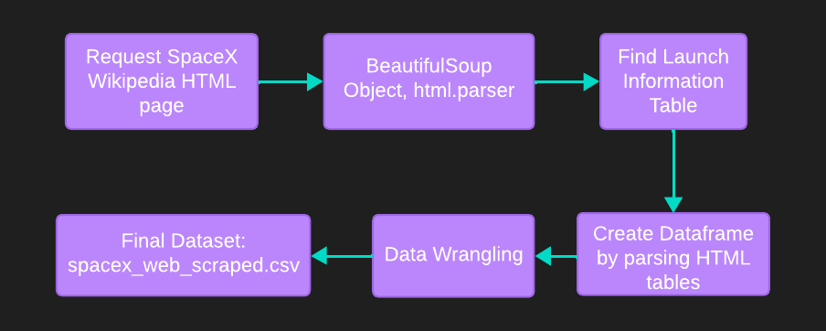
Data Collection - Scraping
Scraping data from a Wikipedia page involves extracting information from the HTML structure of the page using web scraping techniques. I'll provide a general outline of the steps involved in scraping data from a Wikipedia page.
Data Columns: Flight No., Date, Time, Version booster, Launchsite, Payload, Payload mass, Orbit, Customer, Launch Outcome, Booster landing.
GitHub Link

Slide 10
Data Wrangling
In data wrangling process, we encountered diverse mission outcomes related to SpaceX booster landings. These outcomes included cases where landing attempts were made but did not result in a successful landing. To simplify an analysis and prepare the data for predictive modeling, we transformed these outcomes into training labels with a binary classification:
1 was assigned to indicate that the booster successfully landed.
0 was assigned to indicate that the landing was unsuccessful.
True Ocean: Assigned 1 for successful ocean landings, 0 for unsuccessful.
True RTLS: Assigned 1 for successful ground pad landings, 0 for unsuccessful.
True ASDS: Assigned 1 for successful drone ship landings, 0 for unsuccessful.
This simplification streamlines our analysis for accurate predictions.
GitHub Link

Slide 11
EDA with Data Visualization
EDA was conducted on various variables to assess their relationships and suitability for machine learning model training.
Plots Used:
Flight Number vs. Payload Mass: Scatter plot to visualize any patterns or trends.
Flight Number vs. Launch Site: Bar plot to compare launch sites and their frequency.
Payload Mass vs. Launch Site: Scatter plot to explore payload masses by launch site.
Orbit vs. Success Rate: Bar plot depicting the success rate of different orbits.
Flight Number vs. Orbit: Line chart illustrating the distribution of missions across orbits.
Payload vs. Orbit: Scatter plot to analyze payload masses across different orbits.
Success Yearly Trend: Line chart showcasing the yearly trend of mission success rates.
Insights:
Flight Number vs. Payload Mass and Flight Number vs. Orbit revealed potential trends over time.
Launch Site and Payload Mass vs. Launch Site helped identify launch site preferences.
Orbit vs. Success Rate provided insights into mission success rates.
Yearly trend analysis indicated fluctuations in success rates over time.
GitHub Link

Slide 12
EDA with SQL
Process:
Data Loading: We successfully loaded the dataset into an IBM DB2 Database for efficient data management and analysis.
SQL Queries: Leveraging SQL and Python integration, we executed queries to gain deeper insights into the dataset.
Key Queries:
Launch Site Names: We queried launch site names to understand the geographical distribution of SpaceX launches.
Mission Outcomes: Queries were made to gather information about mission outcomes, helping us assess the success rate of SpaceX missions.
Payload Sizes: We queried various payload sizes of customers, providing insights into payload distribution and demand.
Booster Versions: Queries were executed to identify different booster versions used in SpaceX missions, aiding in booster performance analysis.
Landing Outcomes: Information about landing outcomes was extracted through queries, enabling us to analyze the success of booster landings.
GitHub Link

Slide 13
Build an Interactive Map with Folium
Description: We utilized Folium, a Python library, to create an interactive map that enhances our understanding of SpaceX launch sites and their proximity to key locations.
Map Features:
Launch Sites: Marked on the map to show their geographical distribution.
Successful and Unsuccessful Landings: Visualized to understand the outcomes of SpaceX missions in various locations.
Proximity to Key Locations: Demonstrated with examples of proximity to Railway, Highway, Coast, and City.
Purpose:
This interactive map allows us to explore why SpaceX launch sites are strategically located.
It offers a visual representation of successful landings relative to specific geographical locations.
Impact:
This map aids decision-making and site selection for future SpaceX missions.
It provides a clear visual of the success and impact of SpaceX's operations in different areas.
GitHub Link

Slide 14
Build a Dashboard with Plotly Dash
Description: We developed an interactive dashboard using Plotly Dash, offering dynamic insights into SpaceX launch success rates, payload masses, and booster versions.
Dashboard Components:
Pie Chart: Allows users to select from two options: Distribution of successful landings across all launch sites. Individual launch site success rates.
Scatter Plot: Provides two input options:(a) All launch sites or individual sites (b) Payload mass selection within the range of 0 to 10,000 kg.
Purpose:
The Pie Chart visualizes overall launch site success rates.
The Scatter Plot helps analyze success variations across launch sites, payload masses, and booster versions.
Benefits:
Enhanced interactivity for data exploration and decision support. Efficient visualization of launch success patterns and trends.
Impact: This dashboard assists in making informed decisions regarding launch site selection, payload handling, and booster version categorization.
It provides actionable insights into SpaceX mission planning and operations.
GitHub Link

Slide 15
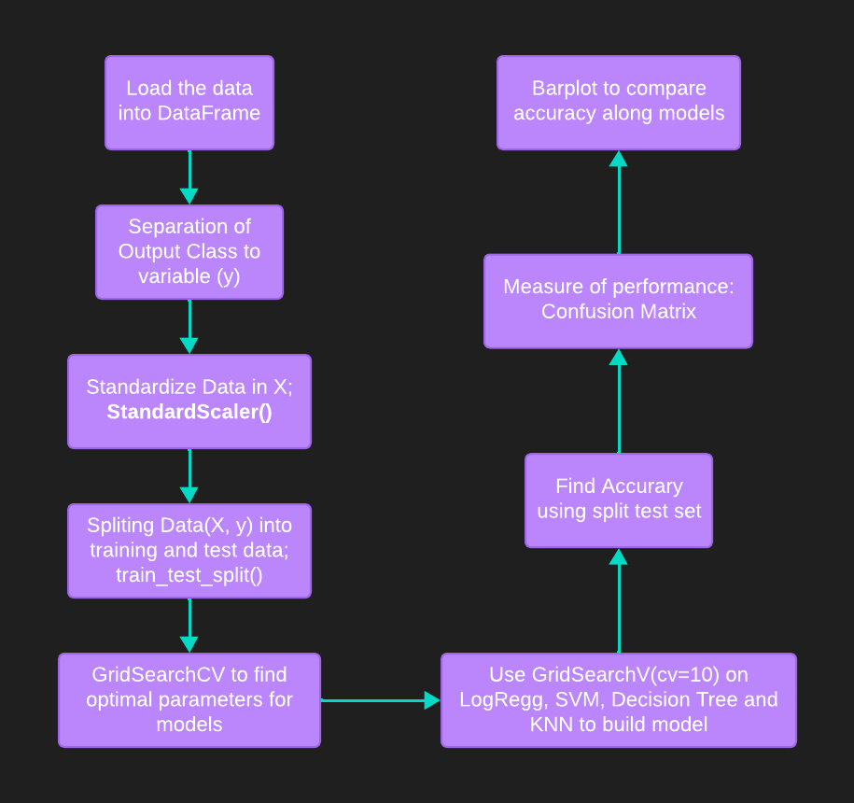
Predictive Analysis (Classification)
Description: We conducted predictive analysis using classification techniques to forecast the success or failure of SpaceX rocket landings.
Purpose: Predictive analysis aids in anticipating mission outcomes, enhancing mission planning, and minimizing risks.
Benefits:
Informed decision-making in real-time, allowing SpaceX to optimize launch strategies.
Improved safety and cost-effectiveness through accurate landing predictions.
Impact: Predictive modeling contributes to the success and sustainability of SpaceX missions, ensuring safe and efficient rocket landings.
GitHub Link

Slide 16
Results
Key Findings: I achieved notable results through extensive data analysis, machine learning, and predictive modeling.
Model Accuracy: All machine learning models (Logistic Regression, Support Vector Machine, Decision Tree Classifier, K Nearest Neighbors) consistently delivered an accuracy rate of approximately 83.33%.
Over-Prediction: All models tended to over-predict successful landings, highlighting the need for additional data for more accurate predictions.
Recommendations: Gather more data to address over-prediction and improve model determination. Continue refining models and exploring advanced machine learning techniques for enhanced accuracy.
Impact: The project lays the foundation for informed decision-making in SpaceX missions, enhancing safety and mission success.
Future Work:
Further research and data collection to refine models.
Exploration of advanced machine learning algorithms and techniques.
Ongoing collaboration to ensure the continued success of space exploration missions.

Slide 17

Section 2

Slide 18
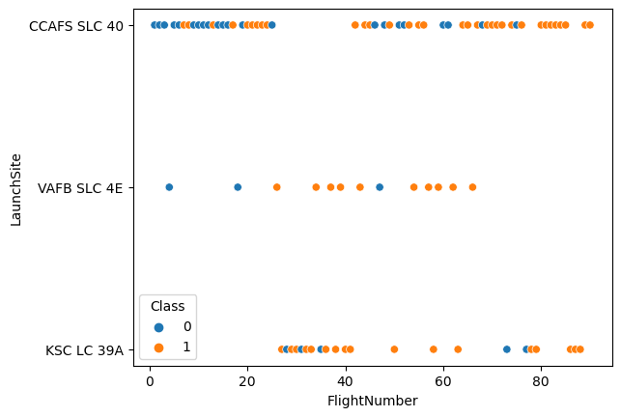
Flight Number vs. Launch Site
Orange indicates successful launch(Class 1)
Blue indicates unsuccessful launch.(Class 0)
Graphic suggests an increase in success rate over time (indicated in Flight Number).
Likely a big breakthrough around flight 20 which significantly increased success rate. “CCAFS SLC 40” appears to be the main launch site as it has the most volume.

Slide 19
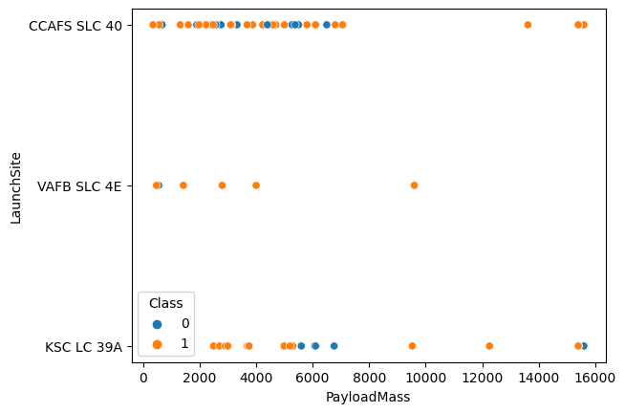
Payload vs. Launch Site
Orange indicates successful launch(Class 1)
Blue indicates unsuccessful launch.(Class 0)
Payload mass appears to fall mostly between 0-7000 kg. Different launch sites also seem to use different payload mass.
The VAFB-SLC launchsite there are no rockets launched for heavy payloadMass(greater than 10000).

Slide 20
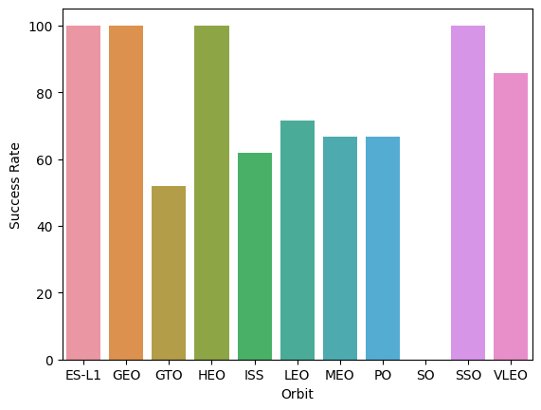
Success Rate vs. Orbit Type
ES-L1 (1): 100% success rate
GEO (1): 100% success rate
HEO (1): 100% success rate
SSO (5): 100% success rate
VLEO (14): Decent success rate with attempts
SO (1): 0% success rate
GTO (27): Around 50% success rate, largest sample
ES-L1, GEO, HEO, and SSO launch site categories have a perfect 100% success rate, albeit with small sample sizes.
VLEO demonstrates a decent success rate while actively attempting missions with a larger sample size.
GTO, with the largest sample size of 27, maintains an approximately 50% success rate.

Slide 21
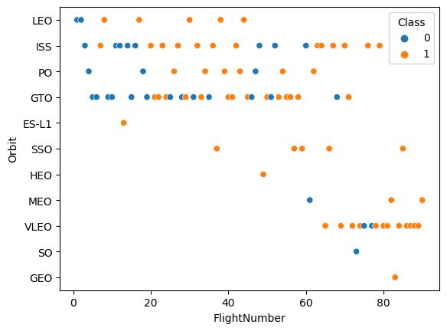
Flight Number vs. Orbit Type
Orange indicates successful launch(Class 1)
Blue indicates unsuccessful launch.(Class 0)
Over time, SpaceX's launch orbit preferences have evolved significantly, correlating with mission outcomes.
Initially, SpaceX predominantly focused on Low Earth Orbit (LEO) missions, achieving moderate success rates.
In recent launches, there has been a shift back to Very Low Earth Orbit (VLEO).

Slide 22
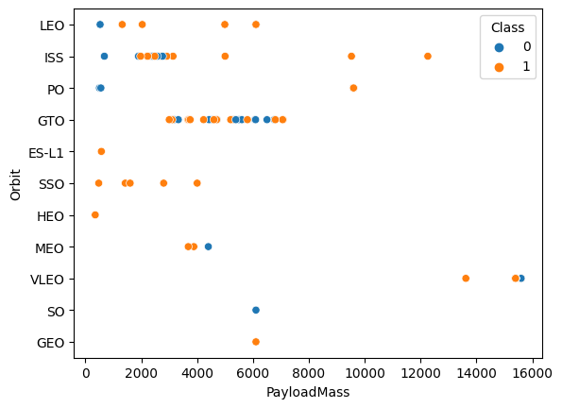
Payload vs. Orbit Type
Orange indicates successful launch(Class 1)
Blue indicates unsuccessful launch.(Class 0)
Low Earth Orbit (LEO) and Sun-Synchronous Orbit (SSO): These orbits tend to have relatively low payload masses.
Very Low Earth Orbit (VLEO): This orbit type primarily accommodates higher-end payload mass values.
Geostationary Transfer Orbit (GTO): Most GTO launches fall within the payload mass range of 3000 to 8000.

Slide 23
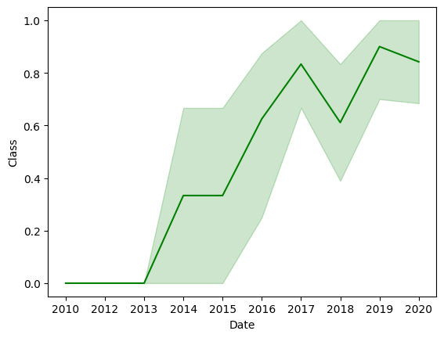
Launch Success Yearly Trend
Since 2013, success rates have generally shown an increasing trend
A slight dip in success rates was observed in 2018.
In recent years, success rates have stabilized at around 80%.
This trend informs future mission planning and risk assessment, contributing to mission success and overall success in space exploration endeavors.

Slide 24
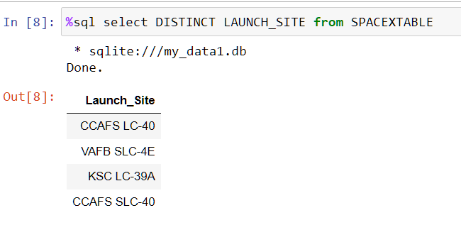
All Launch Site Names
Unique launch site names used by SpaceX:
“CCAFS LC 40” refers to Cape Canaveral Air Force Station Launch Complex 40
“CCAFS SLC 40” stands for Cape Canaveral Air Force Station Space Launch Complex 40
“KSC LC-39A” stands for Kennedy Space Center Launch Complex 39A
“VAFB SLC-4E” refers to Vandenberg Space Force Base Space Launch Complex 4E

Slide 25
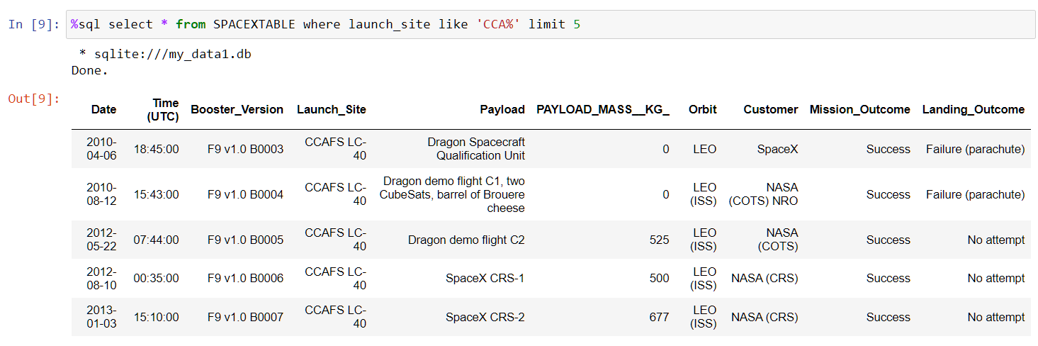
Launch Site Names Begin with 'CCA'
First five entries in database with Launch Site name beginning with “CCA”

Slide 26
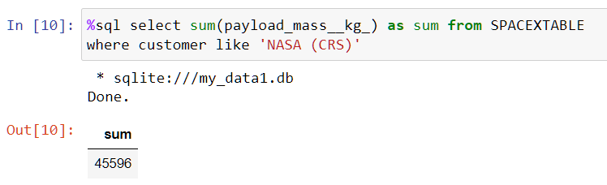
Total Payload Mass
The sum of total payload mass in kilograms where NASA was the customer: 45596 kg
This query filters the dataset to select records where NASA was the customer and the mission was part of the CRS(Commercial Resupply Services) program. It will then calculate the sum of the payload mass in kilograms for these selected records.

Slide 27
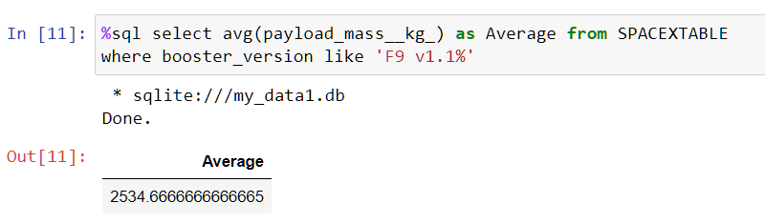
Average Payload Mass by F9 v1.1
The query calculates the average payload mass for SpaceX missions with booster versions starting with 'F9 v1.1' which is 2534.66 kg, providing insights into the typical payload capacity of these missions.

Slide 28
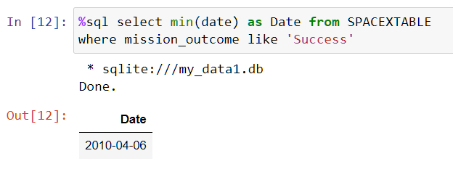
First Successful Ground Landing Date
the query finds the earliest date among missions with a successful outcome in the "SPACEXTABLE" dataset, providing information about the first successful mission date in the dataset which is 6th April, 2010

Slide 29
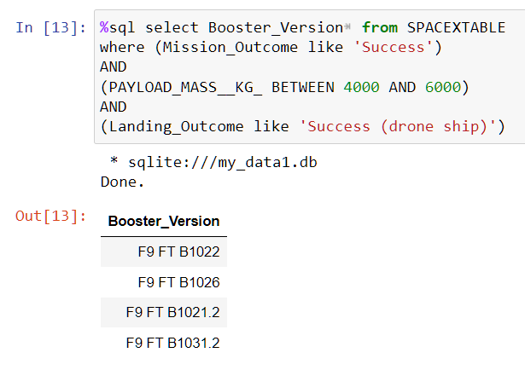
Successful Drone Ship Landing with Payload between 4000 and 6000
This query retrieves the "Booster_Version" for missions meeting these specific criteria, providing information about successful missions within the specified payload mass range that also had successful drone ship landings.
The "Mission_Outcome" is 'Success'
The PAYLOAD_MASS__KG_" is between 4000 and 6000 kilograms.
The "Landing_Outcome" is 'Success (drone ship).'

Slide 30
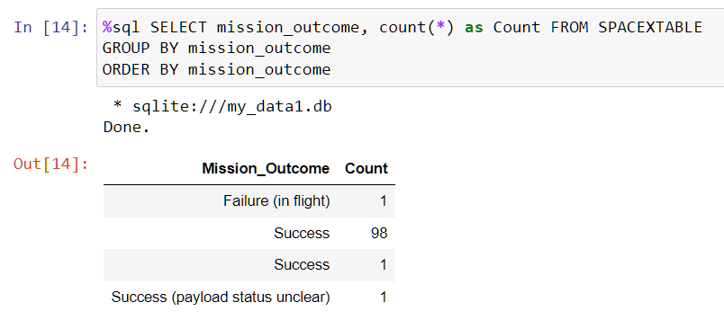
Total Number of Successful and Failure Mission Outcomes
This query retrieves list of total number of successful and failure mission outcomes

Slide 31
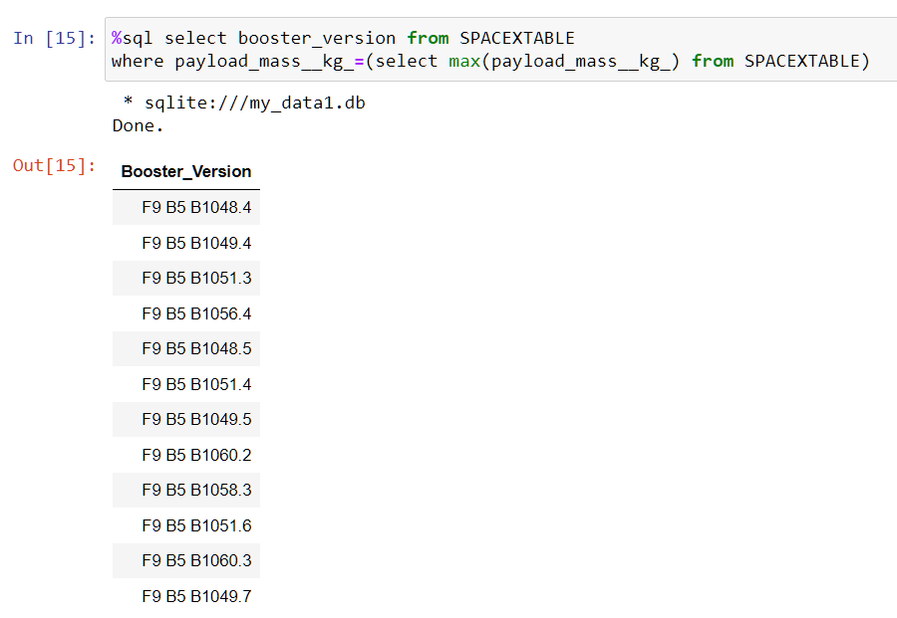
Boosters Carried Maximum Payload
The query identifies the "Booster_Version" used in missions with the maximum payload mass recorded in the "SPACEXTABLE" dataset.

Slide 32
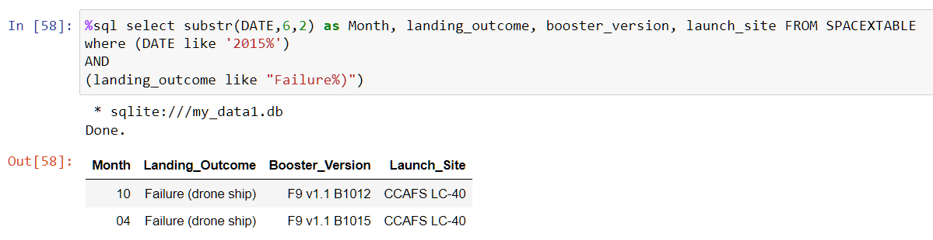
2015 Launch Records
The query retrieves information about missions that occurred in the year 2015, had a landing outcome starting with "Failure," and displays the month, landing outcome, booster version, and launch site for these missions.

Slide 33
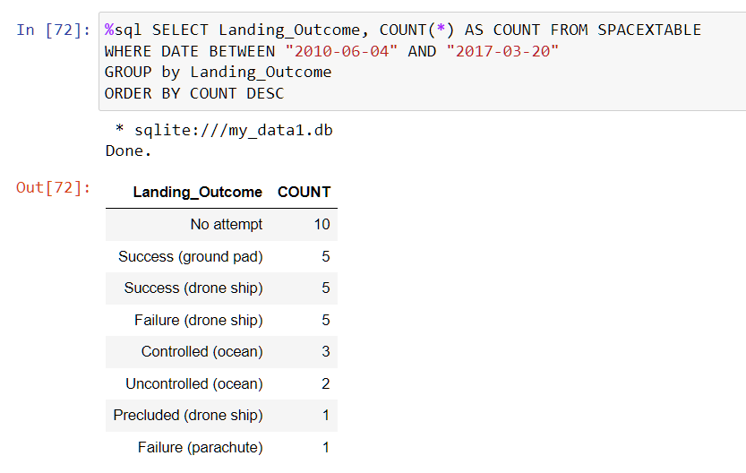
Rank Landing Outcomes Between 2010-06-04 and 2017-03-20
The query retrieves the count of each unique "Landing_Outcome" within a specified date range and orders the results by count in descending order.

Slide 34

Section 3

Slide 35
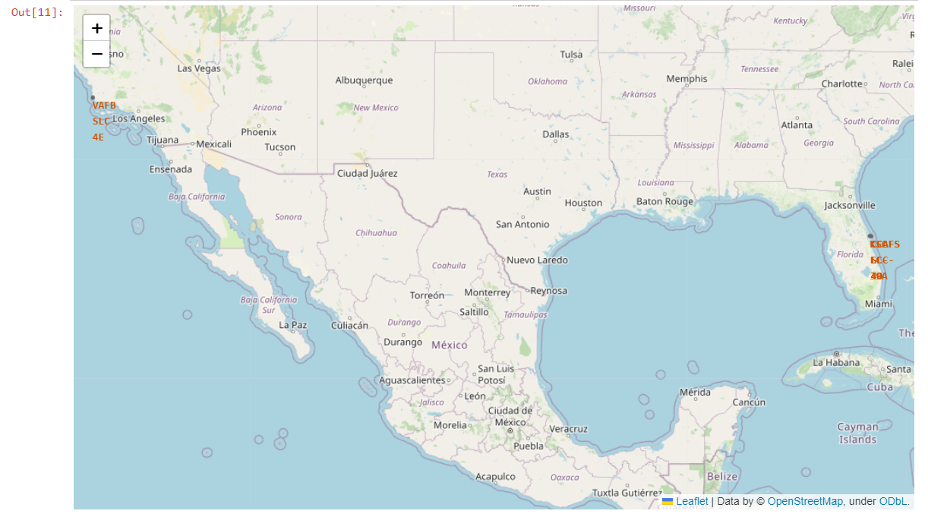
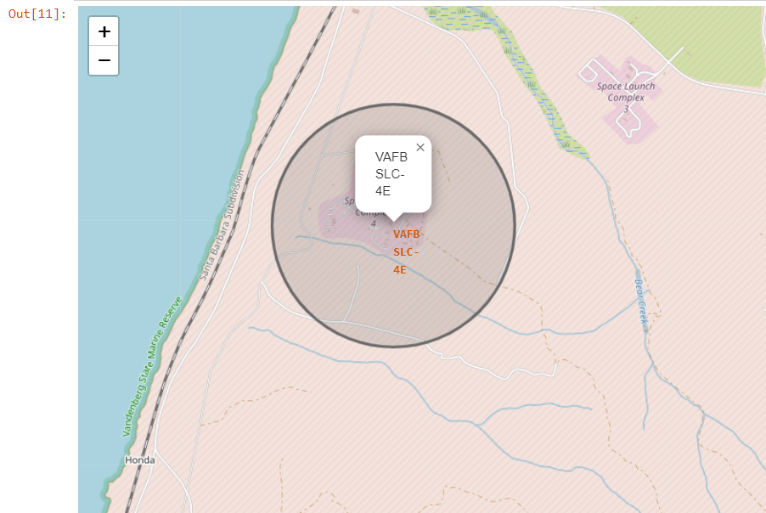
Launch Site Locations
Big Map:
Displaying all SpaceX launch sites relative to a U.S. map.
Highlights the proximity of launch sites to the ocean.
Magnified Map:
Focusing on the specific launch site "VAFB SLC-4E" located near Los Angeles.
Demonstrates the coastal location of launch facilities.
Coastal launch sites provide easy access to a wide range of orbital inclinations.

Slide 36
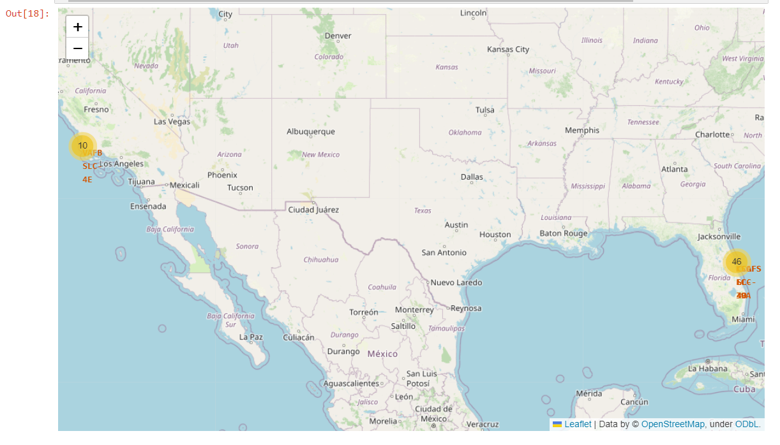
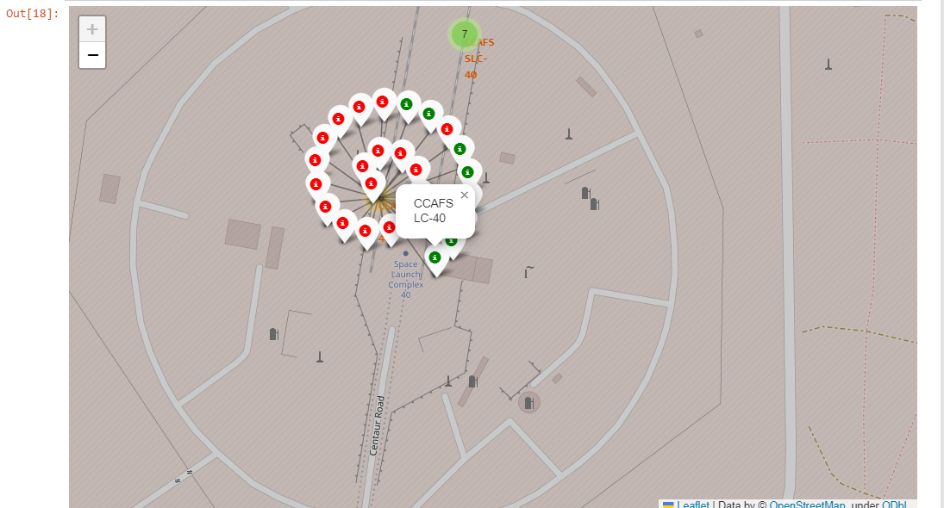
Color-Labeled Launch Outcomes
Green Icon: Successful landings.
Red Icon: Failed landings.
Example: CCAFS LC-40
The magnified map of CCAFS LC-40 shows 7 successful landings (green icon) and 19 failed landings (red icon).
These color-coded maps offer a user-friendly way to assess the success and performance of SpaceX launch sites, assisting in data-driven decision-making for future missions.

Slide 37
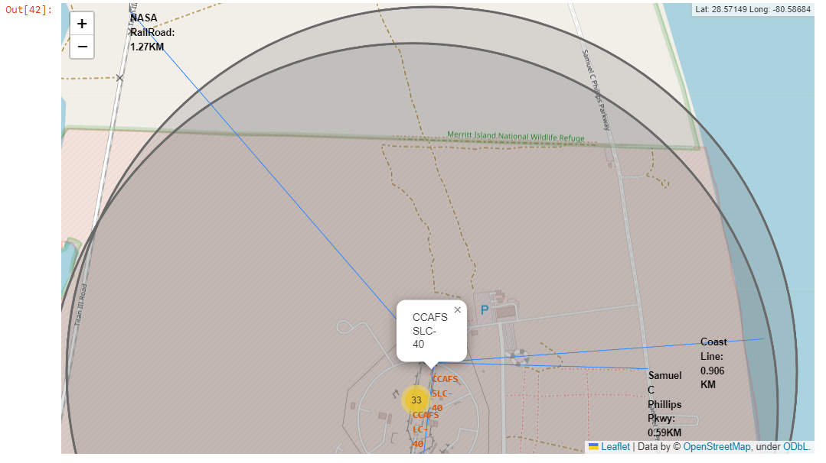
Key Location Proximities
Utilizing “CCAFS SLC-40” as an example, we explore the proximity of launch sites to critical transportation and safety features.
Coast Line (East): 0.91 km
City (Melbourne): 51.76 km
Railway (NASA Rail Road): 1.27 km
Highway (Samuel C Phillips Pkwy): 0.59 km
Proximity to railways, highways, and cities aids in efficient payload transport and launch operations.

Slide 38

Section 4

Slide 39
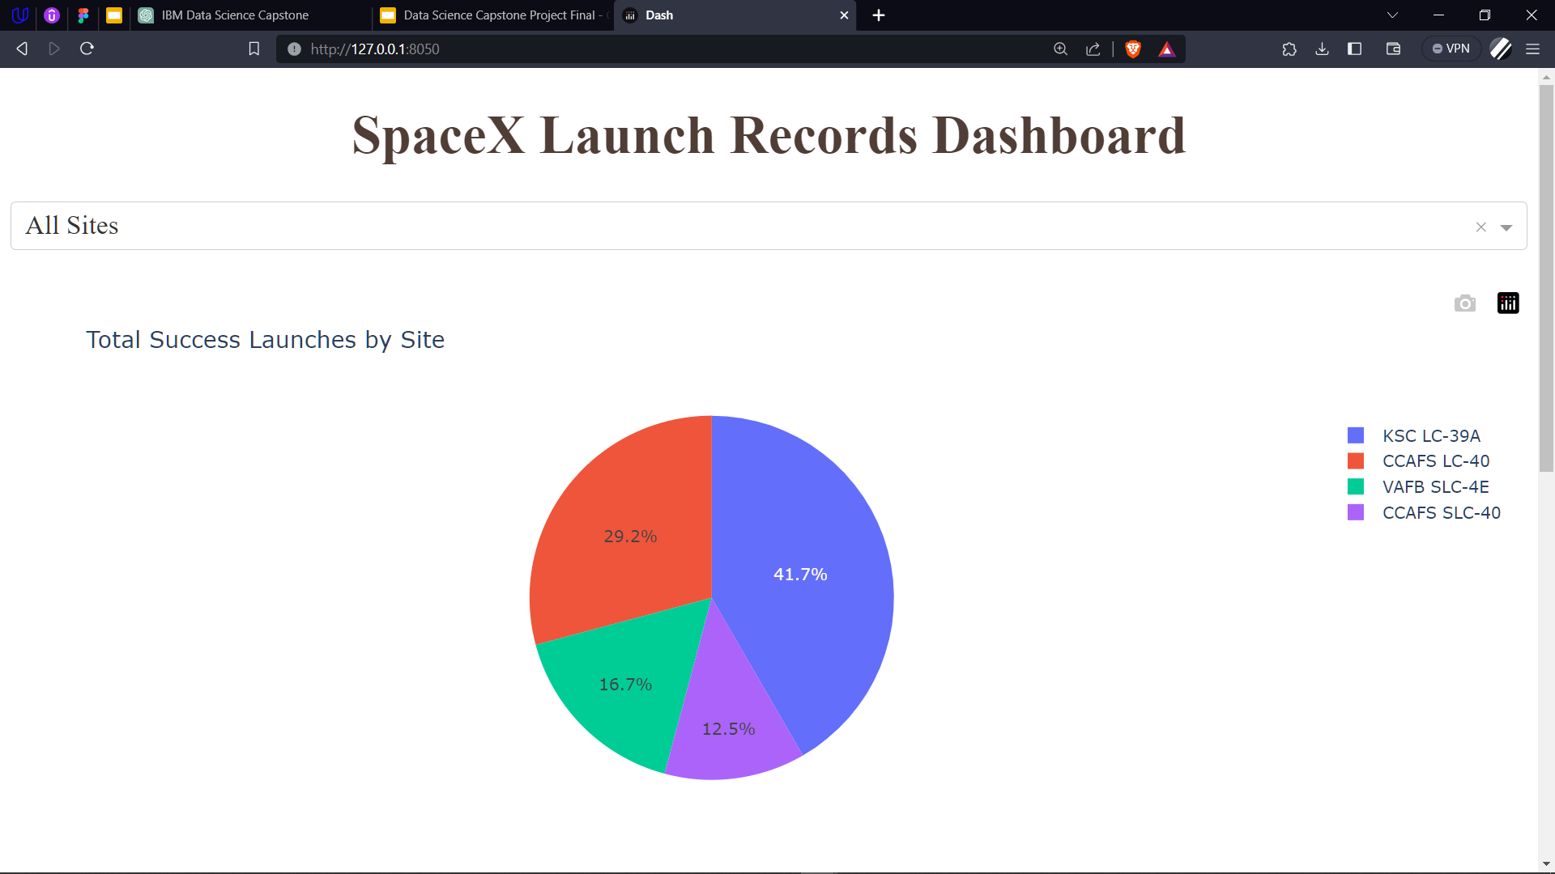
Successful Launches by Launch Sites
Pie Chart: Represents the distribution of successful landings across all SpaceX launch sites.
KSC LC-39A has the highest percentage of successful landings, comprising 41.7%.
CCAFS LC 40 and VAFB SLC-4E also show significant success rates at 29.2% and 16.7%, respectively.
CCAFS SLC 40 contributes with a 12.5% success rate.

Slide 40
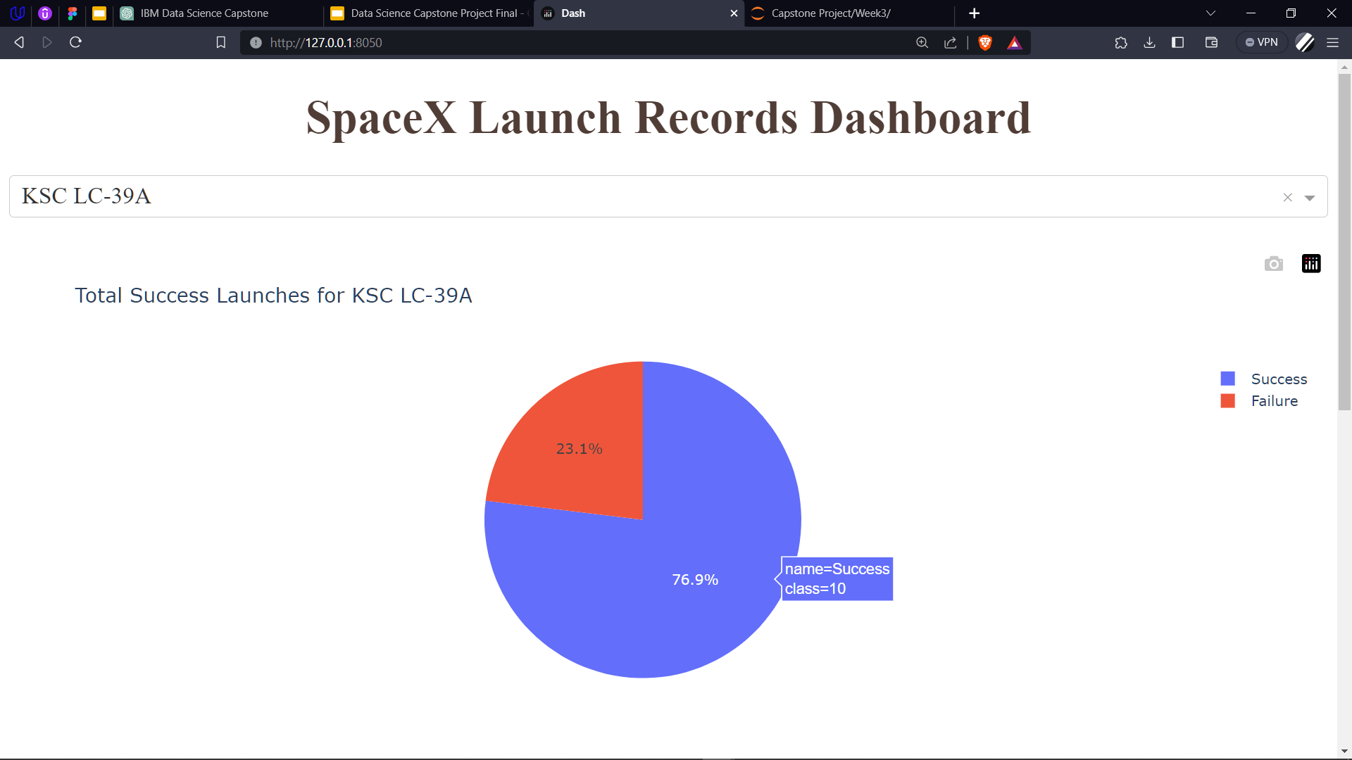
Highest launch success ratio Launch Site
KSC LC-39A: This launch site stands out with the highest success rate, marked in Blue, featuring 10 successful landings and 3 failed landings.
KSC LC-39A demonstrates a strong track record, making it a strategic choice for future missions.
This distribution provides a clear overview, highlighting KSC LC-39A as a top-performing site.

Slide 41
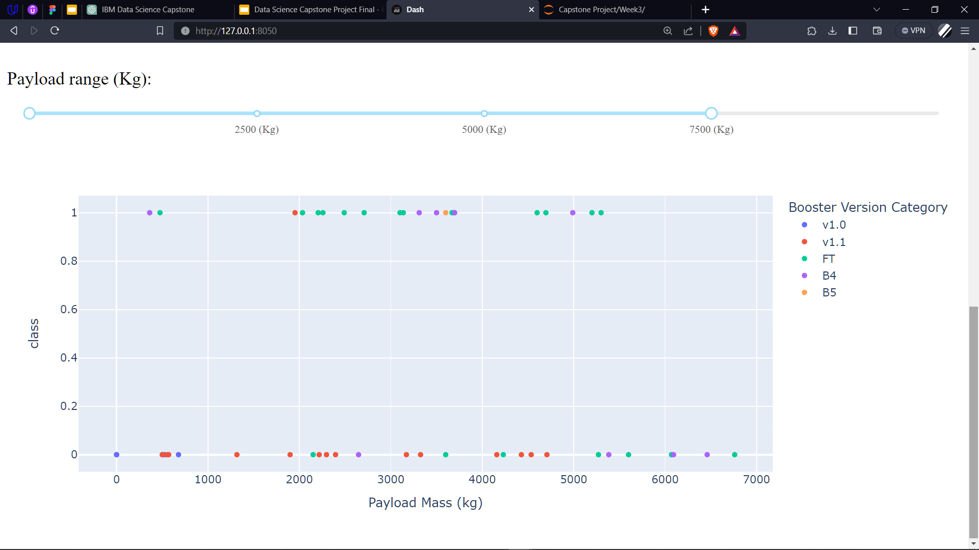
Payload Mass vs. Success vs. Booster Version Category
Payload Range Selector: Allows users to select the payload mass range(0 kg to 10,000 kg).
Class Indicator: Classifies successful landings as "1" and failures as "0."
Scatter Plot: Displays the payload mass on the x-axis, success/failure on the y-axis, booster version category in color, and the number of launches represented by point size.

Slide 42

Section 5

Slide 43
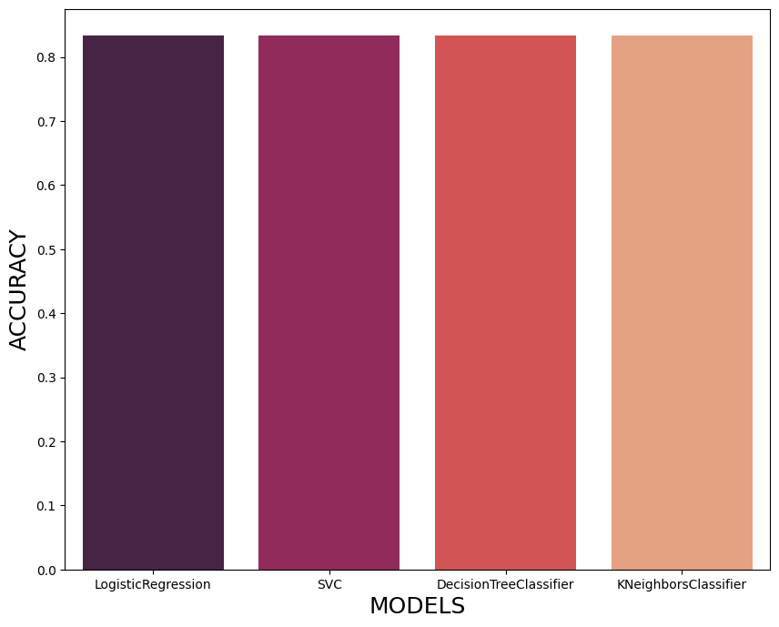
Classification Accuracy
Model Comparison: All machine learning models produced virtually identical accuracy on the test set, achieving 83.33% accuracy.
While the current results are promising, expanding the dataset can help provide more robust and reliable insights into model performance.
This slide emphasizes the accuracy achieved in the current dataset while acknowledging the potential impact of small test sizes on variability and the need for additional data for more confident model assessments.

Slide 44
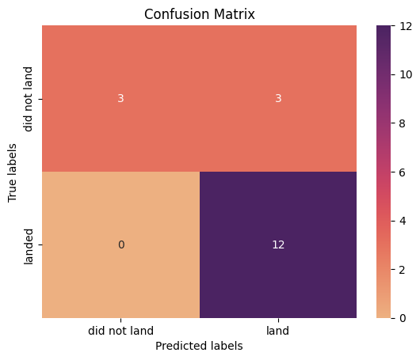
Confusion Matrix
True Positives (TP): There are 3 cases where the model correctly predicted positive outcomes.
True Negatives (TN): There are 12 cases where the model correctly predicted negative outcomes.
False Positives (FP): There are 3 cases where the model incorrectly predicted positive outcomes when the actual outcome was negative.
False Negatives (FN): There are no cases where the model incorrectly predicted negative outcomes when the actual outcome was positive.

Slide 45
Conclusions
Data Collection and Wrangling: The project began with data collection from public sources, including SpaceX APIs and Wikipedia. Data wrangling involved cleaning, transforming, and preparing the dataset for analysis.
Exploratory Data Analysis (EDA): EDA revealed trends in launch success over time, payload mass correlations with orbit types, and the significance of launch site locations.
Visualization and Interactive Tools: The project incorporated Folium maps, Plotly Dashboards, and charts to visually represent the data, enhancing our understanding of launch site locations and success factors.
Predictive Analysis: Four machine learning models were developed, showing consistent accuracy of 83.33% on a small test set. However, the small dataset size suggests the need for more data to determine the best model.
Strategic Insights: The analysis highlighted the importance of coastal launch sites, proximity to transportation infrastructure, and the reliability of KSC LC-39A.
Future Directions: To improve model determination and accuracy, future work should focus on gathering additional data and exploring advanced machine learning techniques.
This project provides valuable insights into SpaceX's launch operations, laying the foundation for data-driven decisions and strategic planning in space exploration.

Slide 46
Appendix
GITHUB REPOSITORY LINK:
https://github.com/ganeshs14/AppliedDSCapstone/tree/main
Thanks to all Instructors:
Dr. Pooja, Romeo Kienzler, Joseph Santarcangelo, Polong Lin, Alex Aklson, Rav Ahuja, Saishruthi Swaminathan, Saeed Aghabozorgi, Hima Vasudevan, Azim Hirjani, Aije Egwaikhide, Yan Luo, Levitan Svetlana.
Special Thanks to Coursera and IBM

Slide 47


